Slide 1
The Role of Business Research
Chapter 1
Business Research Methods - William G. Zikmund

Slide 2
Business Research Defined
Business research is the application of the scientific method in searching for the truth about business phenomena.
Business research is conducted to provide valid and reliable answer(s) to already posed research questions.
It facilitates the managerial decision process by providing the intelligence to businesses.
Business research information is not intuitive or haphazardly gathered.
Literally, research (re-search) means “to search again”.
All findings are tied back to the underlying theory
The definition also emphasizes, through reference to the scientific method, that any information generated should be accurate and objective.
Note that research is an aid to managerial decision making, never a substitute for it.
Sudha Bhagavatheeswaran, Department of Information Technology,
SIES College of Arts, Science & Commerce (Autonomous)

Slide 3
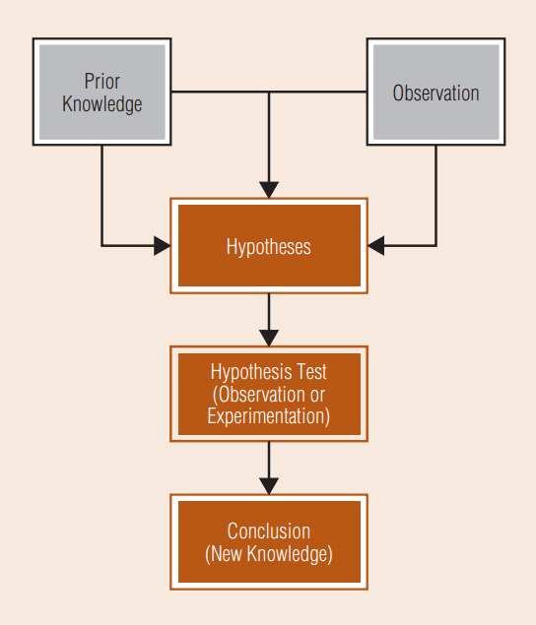
Applied and Basic Business Research
Applied business research – specific
Basic business research / Pure research - generic
The Scientific Method
Sudha Bhagavatheeswaran, Department of Information Technology,
SIES College of Arts, Science & Commerce (Autonomous)

Slide 4
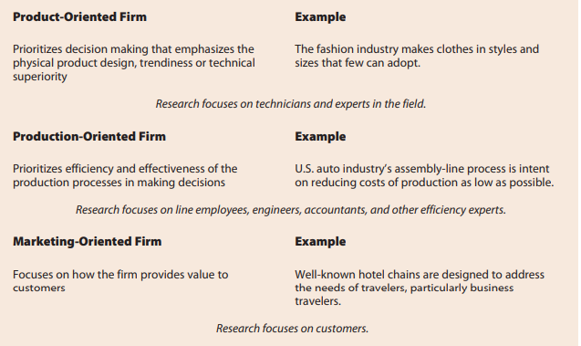
Managerial Value of Business Research
Product Oriented
Production Oriented
Marketing Oriented

Slide 5





Decision – Making Process
Diagnosing and Assessing Problems or Opportunities
Identifying Problems or OpportunitieS
Evaluating the Course of Action
Selecting and Implementing a Course of Action
Evaluation Research
Performance – Monitoring Research
Sudha Bhagavatheeswaran, Department of Information Technology,
SIES College of Arts, Science & Commerce (Autonomous)
Notes:
© Copyright PresentationGO.com – The free PowerPoint and Google Slides template library

Slide 6
When Is Business Research Needed?
Is sufficient time available before a decision will be made?
01
Time Constraints
Is it feasible to obtain data?
Availability of data
02
Is the decision
of considerable
strategic or tactical
importance?
Nature of the Decision
03
Does the value of the
research information
exceed the cost of
conducting research?
Benefits v/s Costs
04
Sudha Bhagavatheeswaran, Department of Information Technology,
SIES College of Arts, Science & Commerce (Autonomous)
Notes:
© Copyright PresentationGO.com – The free PowerPoint and Google Slides template library

Slide 7
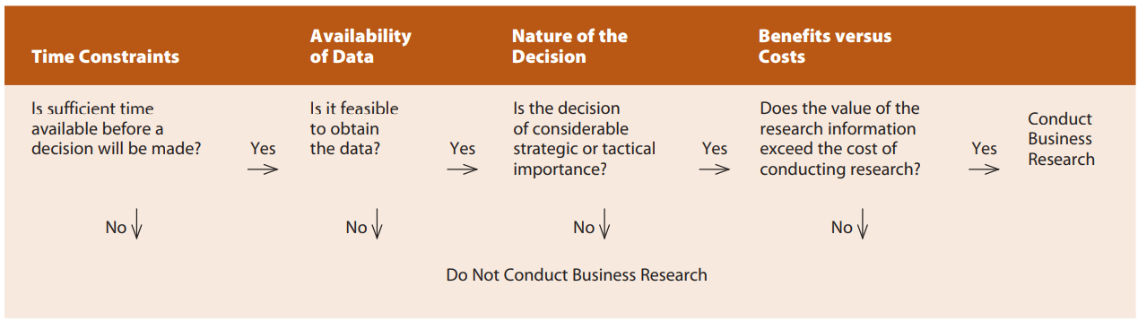
When Is Business Research Needed?

